Slide 1
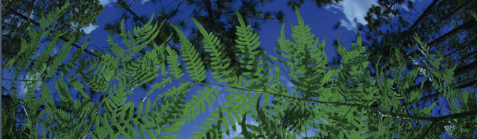

Ecological Niche Modeling Using Maxent
University of Florida

Slide 2
Outline of processing layers with QGIS
1 – Create species-specific training data
Load occurrence data
Create Alpha Hull
Calculate Distance Matrix
Calculate Basic Statistics for Buffer
Reproject Layer
Create Buffer
Create clipped mask
2 – Comparing processes: species-specific vs all species
3 – Open Maxent
4 – Load occurrence data
5 – Load species-specific training layers

Slide 3
Outline of processing layers with QGIS
6 – Select output directory
7 – Verify output formats
8 – Verify settings:
9 – Verify settings – Basic
10 – Verify settings – Advanced
11 – Verify settings – Experimental
12 – Run Maxent

Slide 4
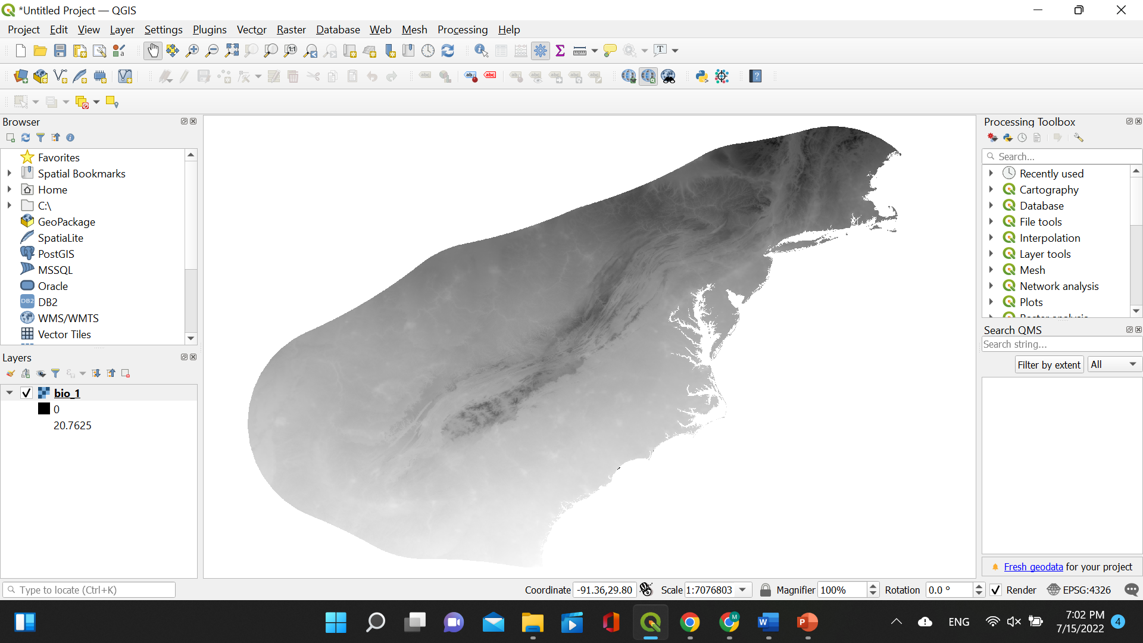
Create species-specific training data
Load one of the clipped bioclim layers that we selected in the previous steps, during the Climate Layer Processing activity

Slide 5
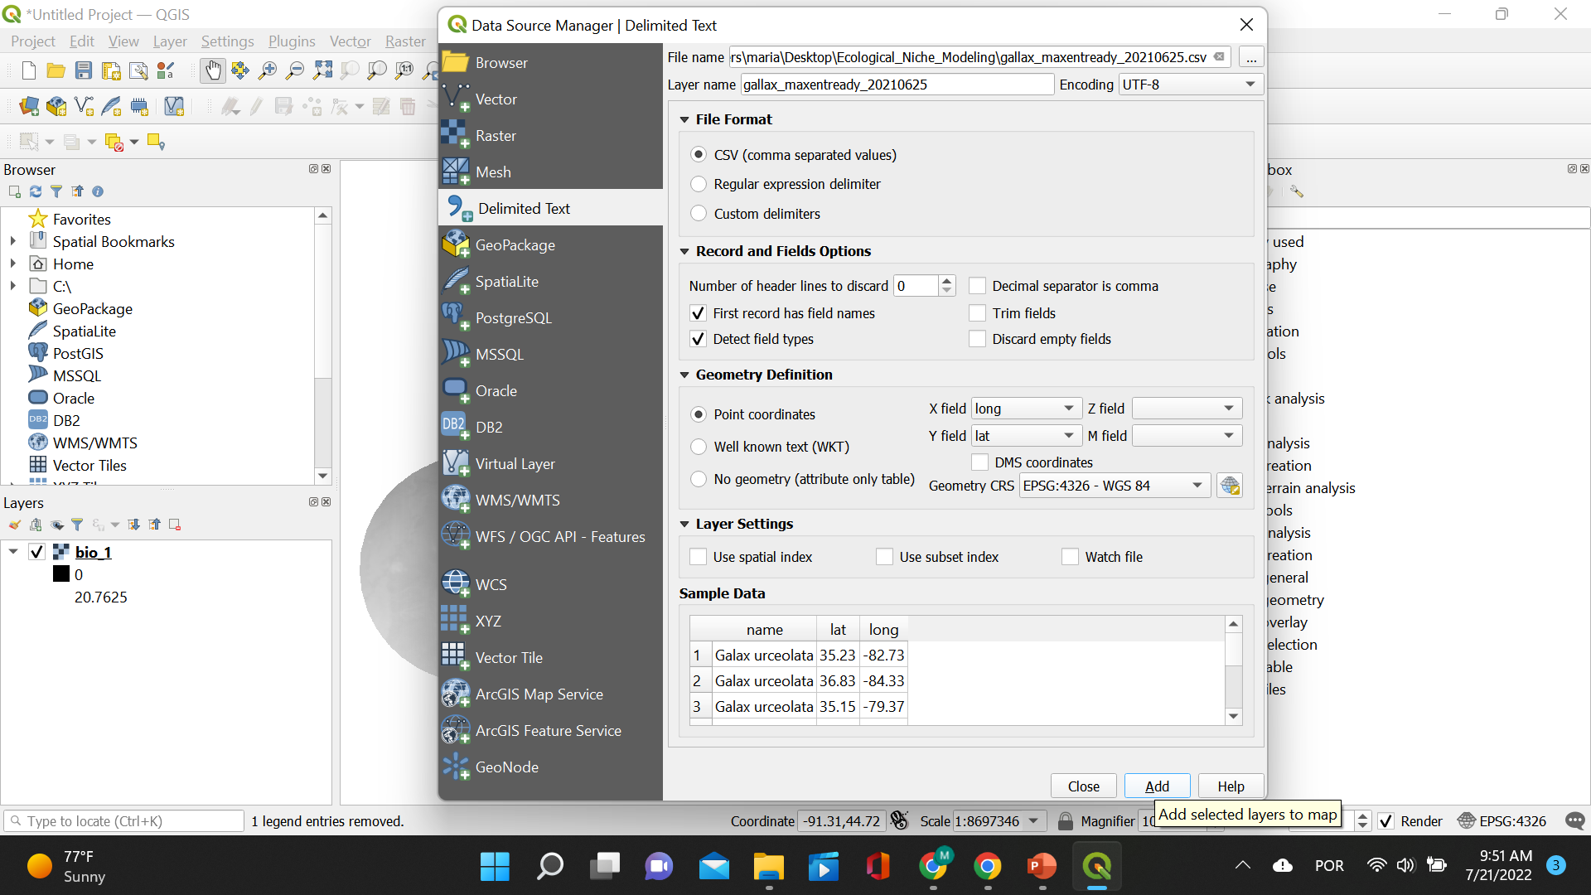
Create species-specific training data
Choose the occurrence file for Galax urceolata saved as .csv. Set the “X field” as longitude and the “Y field” as latitude. Make sure the “Geometry CRS” is set as EPSG:4326 – WGS 84. Click “Add”.

Slide 6
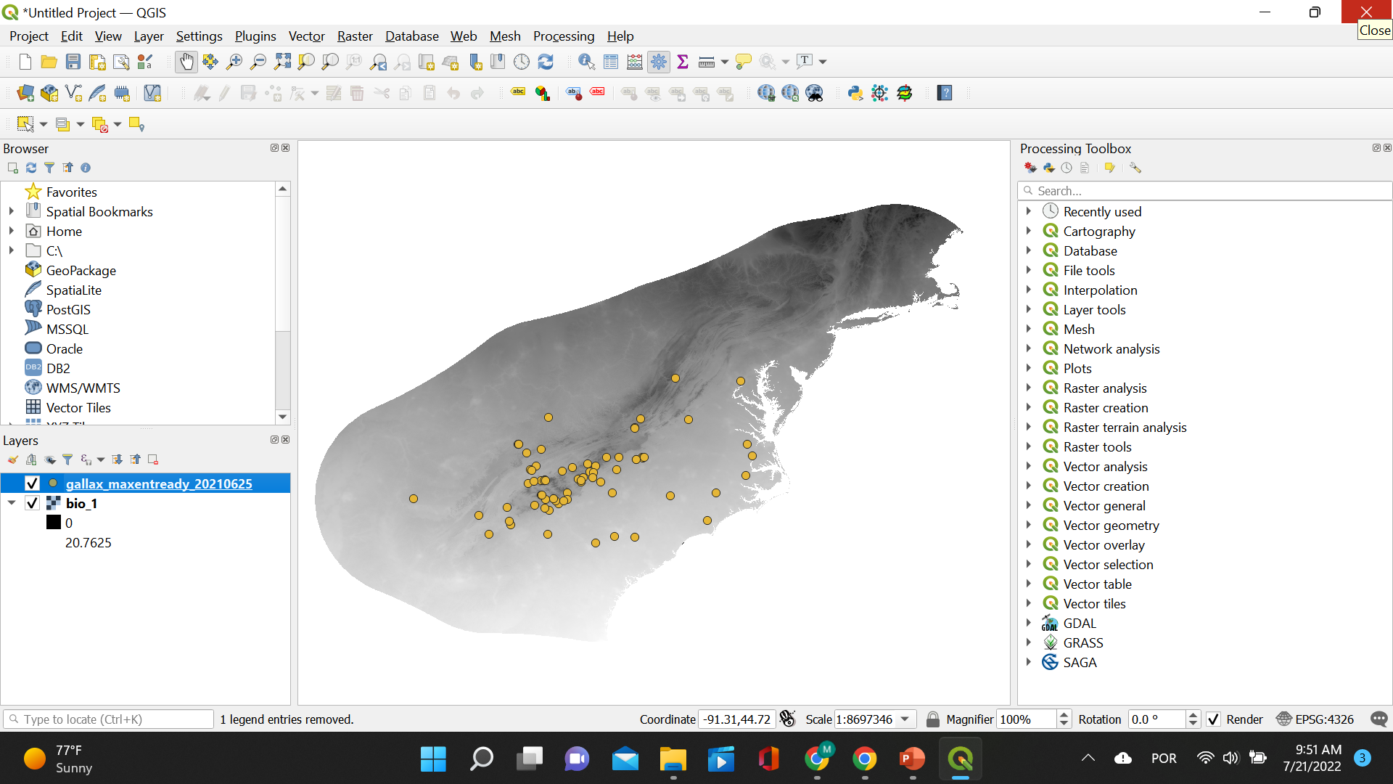
Create species-specific training data
The occurrences for Galax urceolata will be displayed on top of the bioclim layer. They will be listed in the window “Layers”.

Slide 7
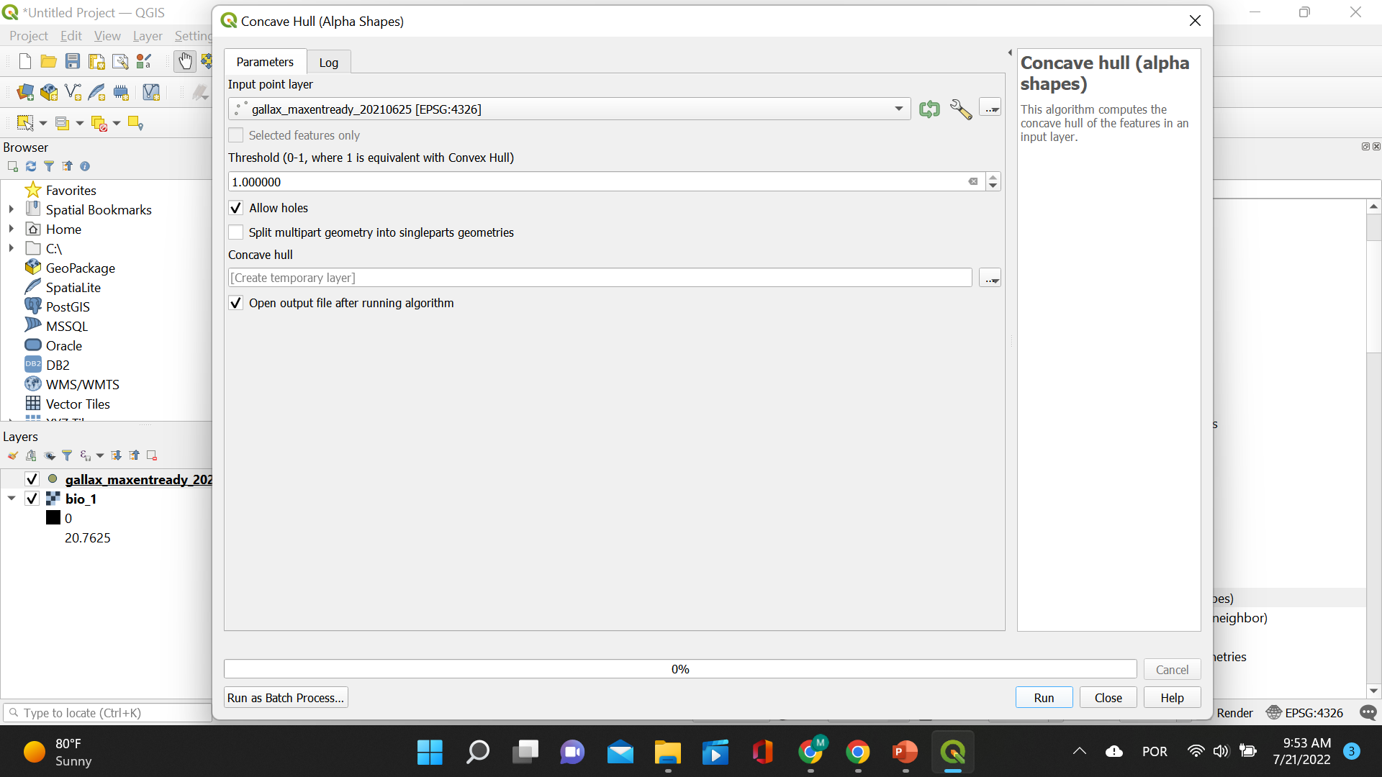
Create species-specific training data
CREATE THE ALPHA HULL! Choose the occurrence data layer under “Input point layer”, set threshold to 1, and click “Run”.

Slide 8
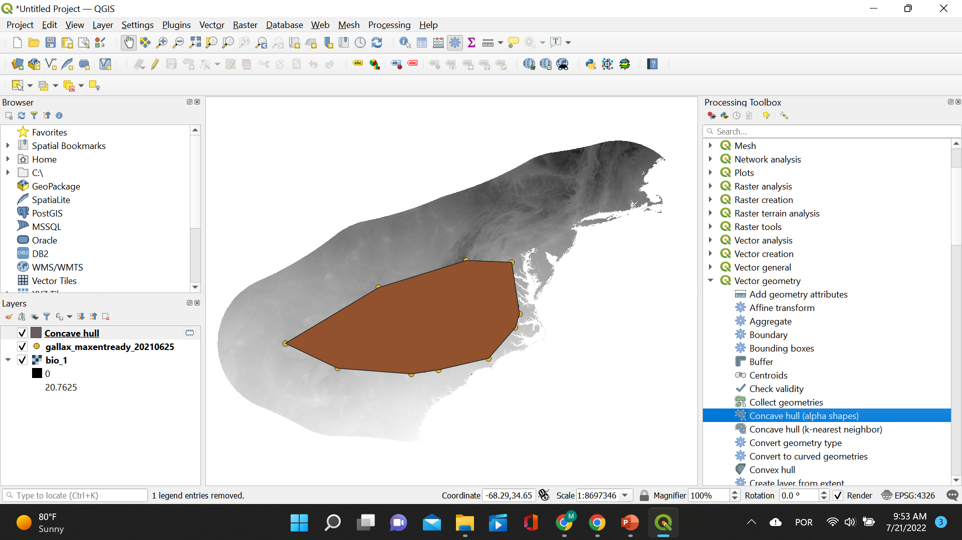
Create species-specific training data
The concave alpha hull will be displayed as a layer on top of the two previous layers.

Slide 9
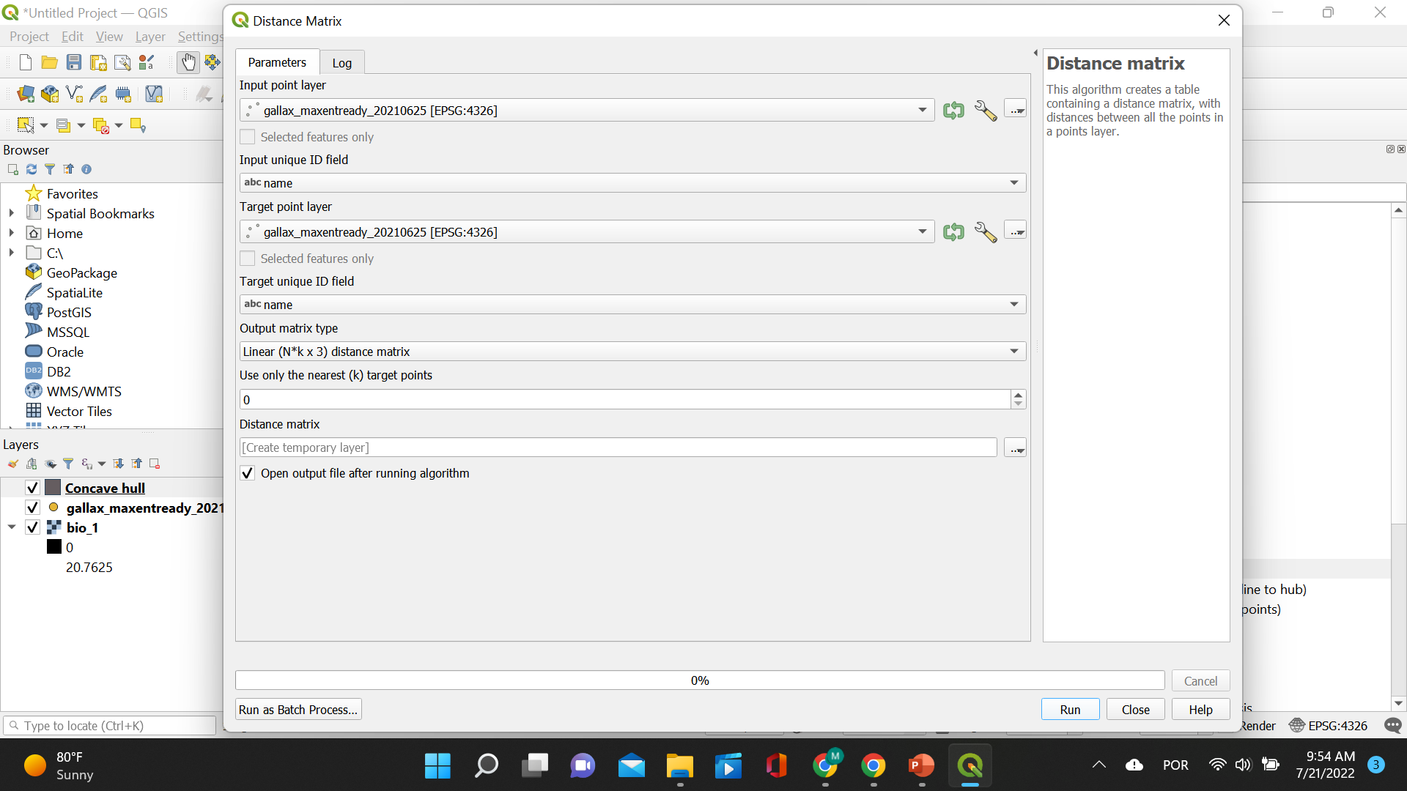
Create species-specific training data
CREATE A DISTANCE MATRIX! Choose the occurrence data layer for “Input point layer” and “Target point layer”. Then choose abc name for “Input unique ID field” and “Target unique ID field”. Click “Run”.

Slide 10
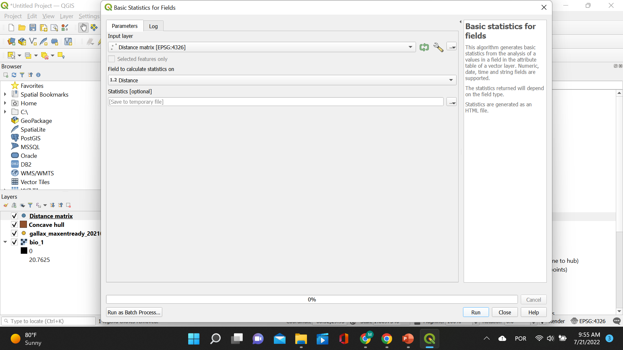
Create species-specific training data
CALCULATE BASIC STATISTICS FOR FIELDS! Choose the distance matrix layer for “Input layer” and the last column Distance for “Field to calculate statistics on”. Then click on the three dots under “Statistics” and click “Save to File” and choose a name and a path to save your file.

Slide 11
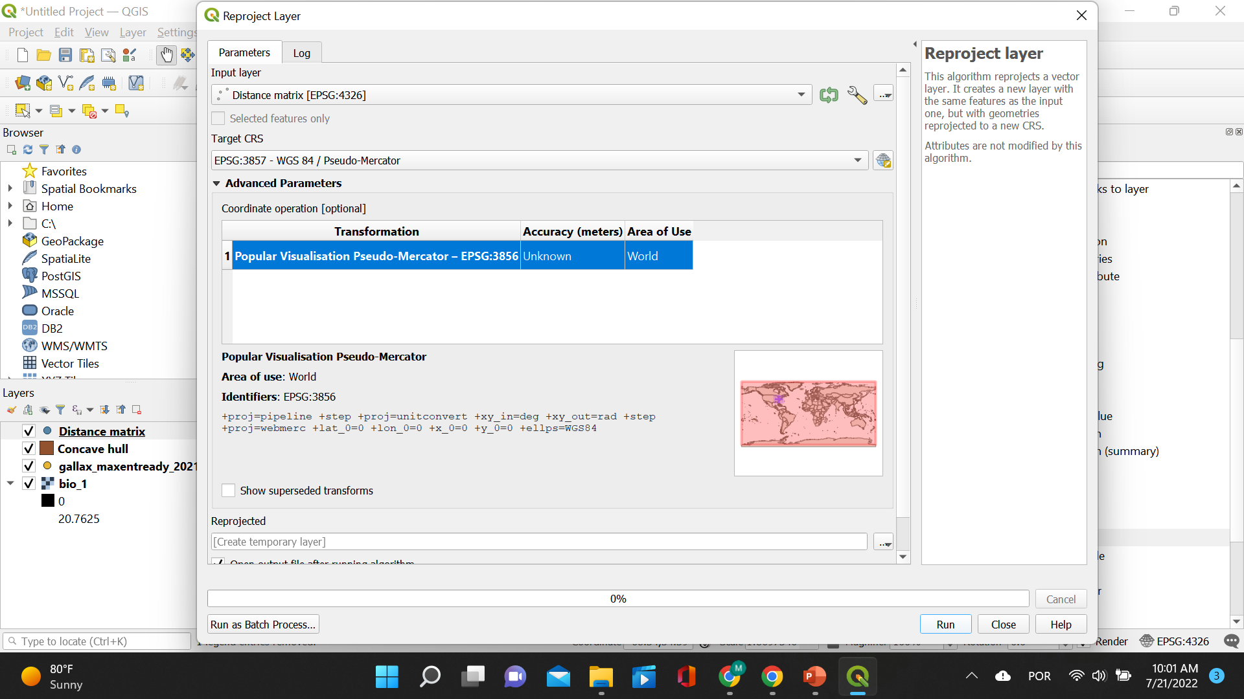
Create species-specific training data
REPROJECT THE LAYERS! Choose the concave hull layer for “Input layer” and set the “Target CRS” as EPSG:3857 – WGS 84 / Pseudo-Mercator. Then click “Run”.

Slide 12
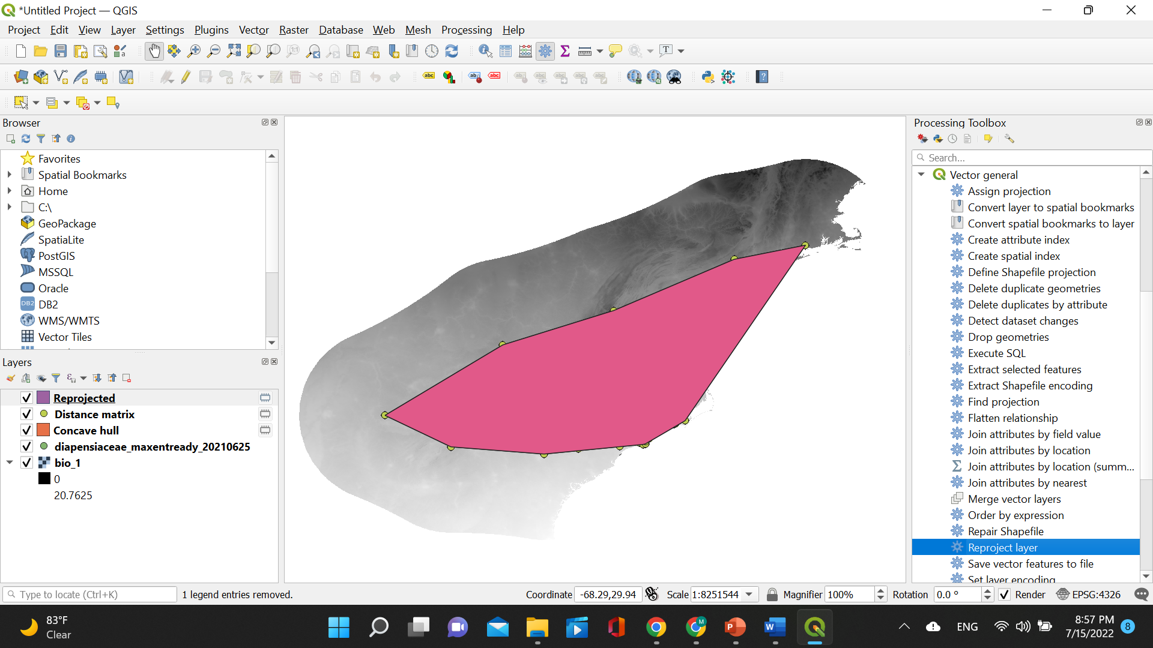
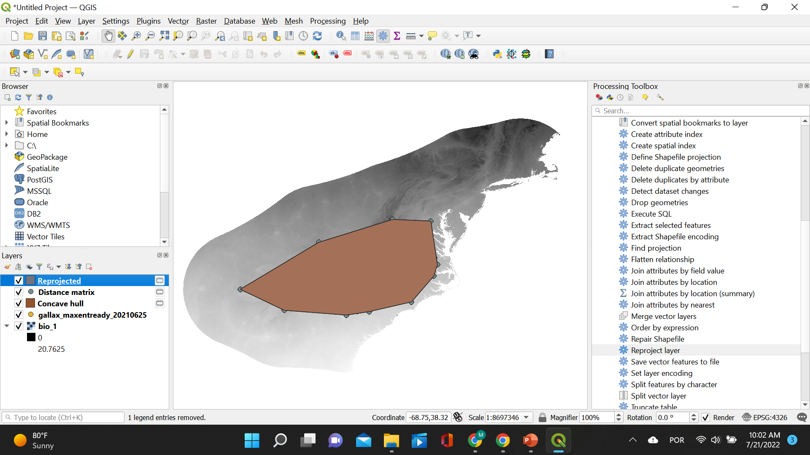
Create species-specific training data
The reprojected layer will be displayed. Note it is shaped differently than the reprojected layer considering occurrence data for all species.

Slide 13
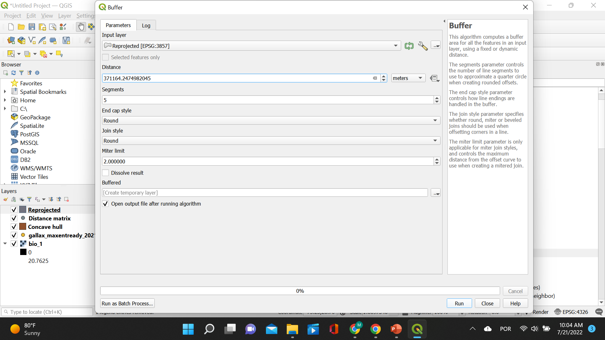
Create species-specific training data
CREATE THE BUFFER! Choose the reprojected layer for “Input layer” and set the “Distance” to the value found for the “Third quartile” (in this case 371164.2474982045). Then click “Run”.

Slide 14
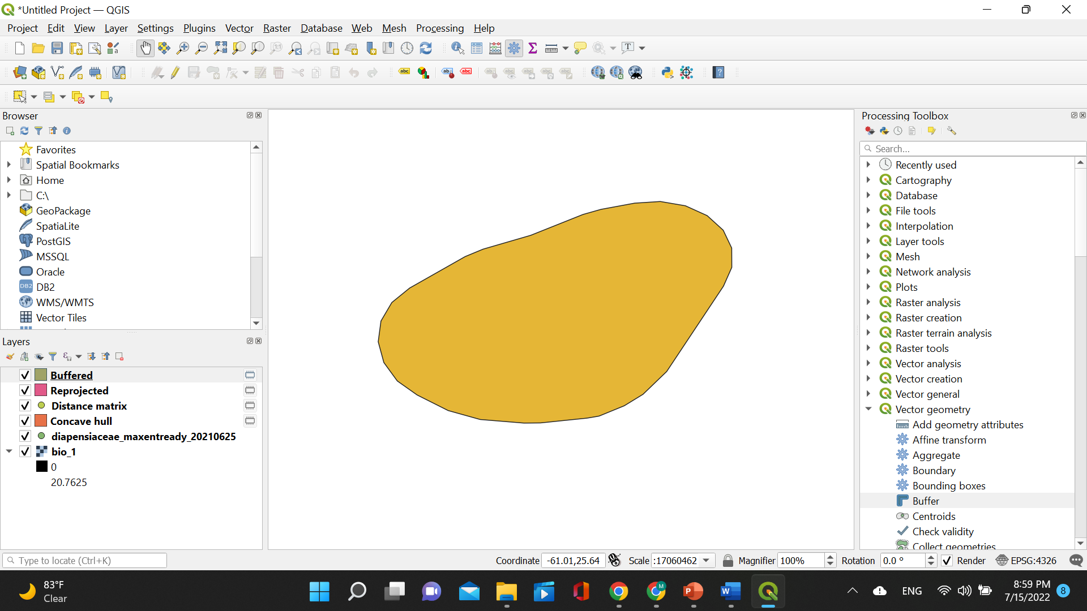
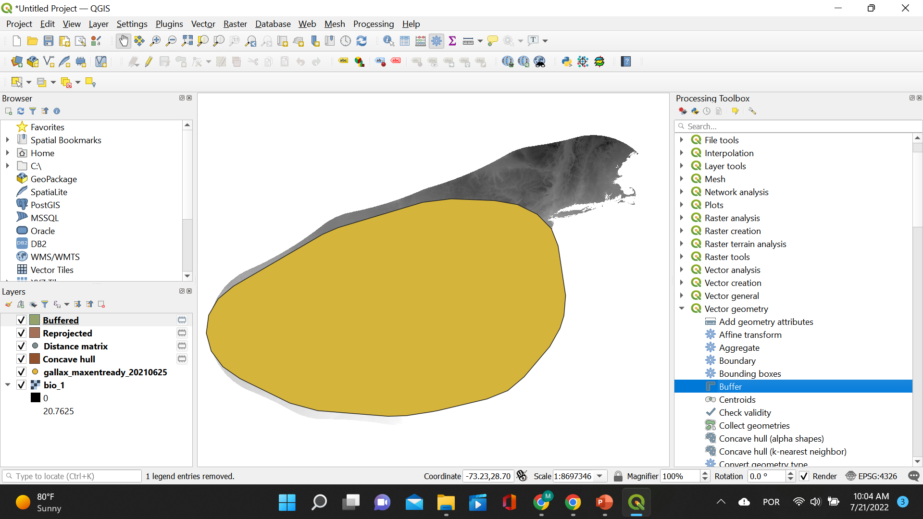
Create species-specific training data
The buffered layer will be displayed on top of the five previous layers. Again, note it is shaped differently than the buffered layer considering occurrence data for all species.

Slide 15
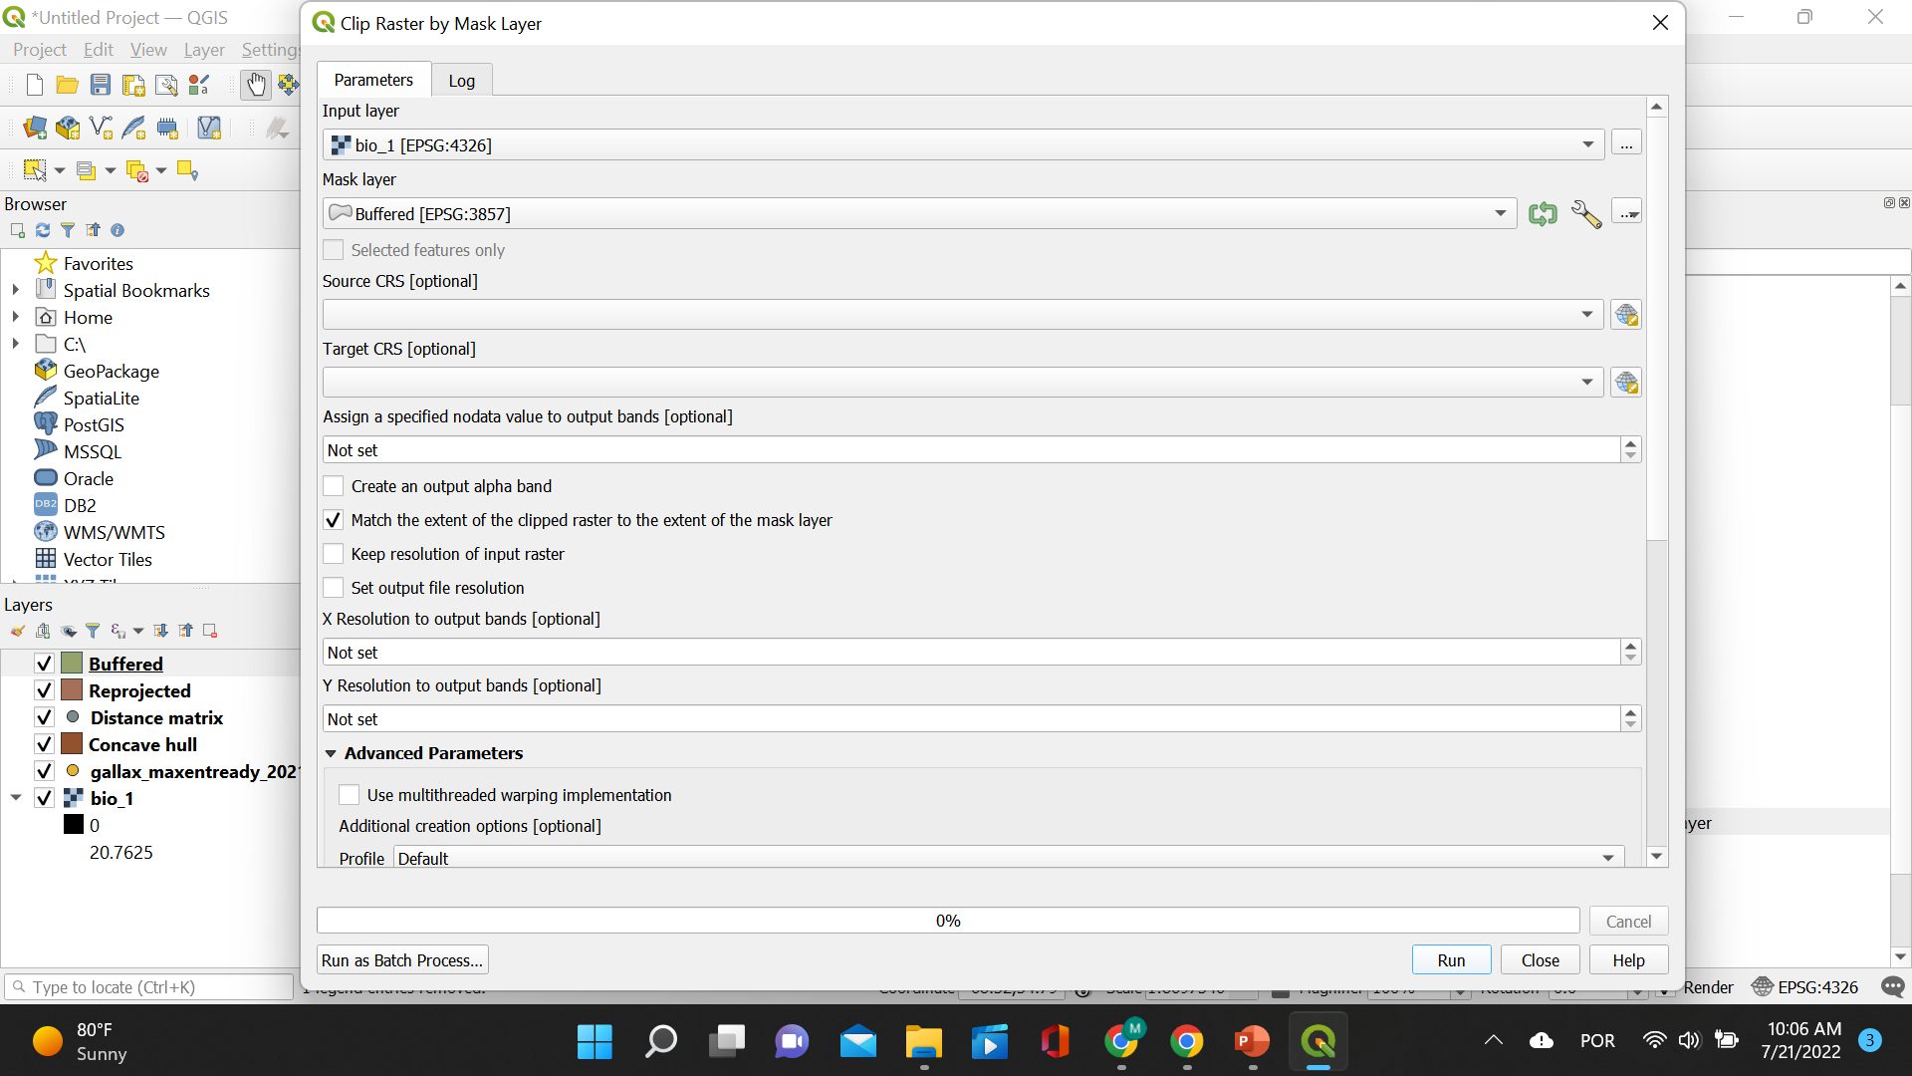
Create species-specific training data
CLIP RASTER! Choose the bioclim layer for “Input layer” and the buffered layer for “Mask layer”. Then click “Run”.

Slide 16
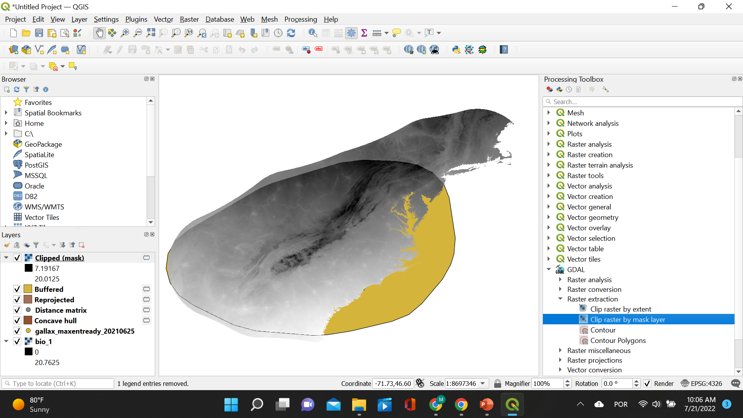
Create species-specific training data
The clipped layer will be displayed on top of the six previous layers.

Slide 17
Outline of processing layers with QGIS
Repeat this process for all the layers you will be using in Maxent. For our illustrative example, these layers would be:
Bioclim 3
Bioclim 7
Bioclim 8
Bioclim 9
Bioclim 14
Bioclim 15
Bioclim 18
ELEVATION

Slide 18
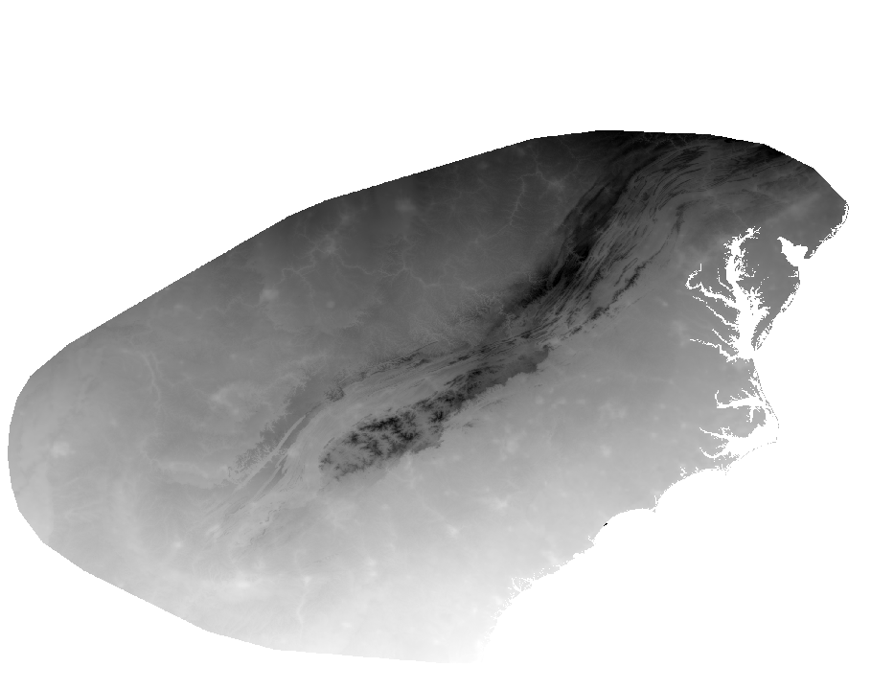
Comparing processes: species-specific vs all species
Species-specific clipped layer for Galax urceolata
Clipped layer considering occurrence points of all species – in Maxent this will be called “Projected layer”

Slide 19
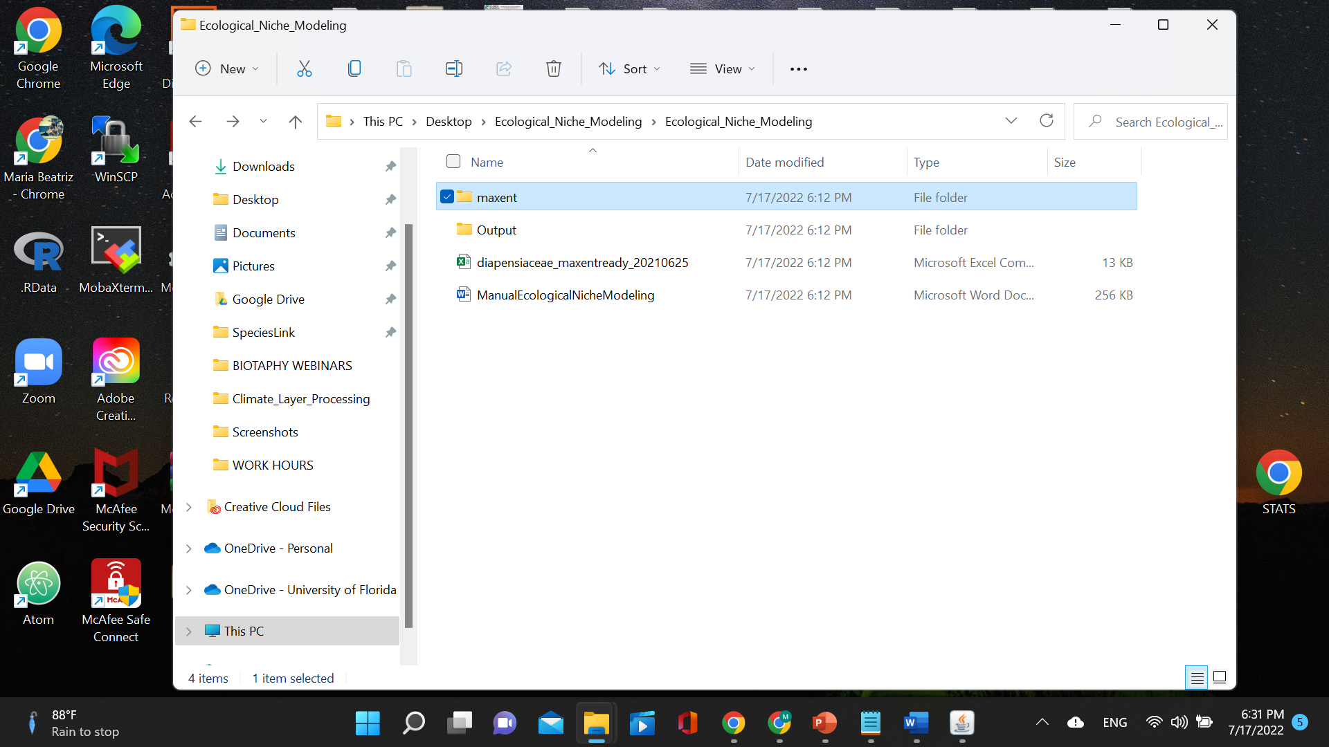
Open Maxent

Slide 20
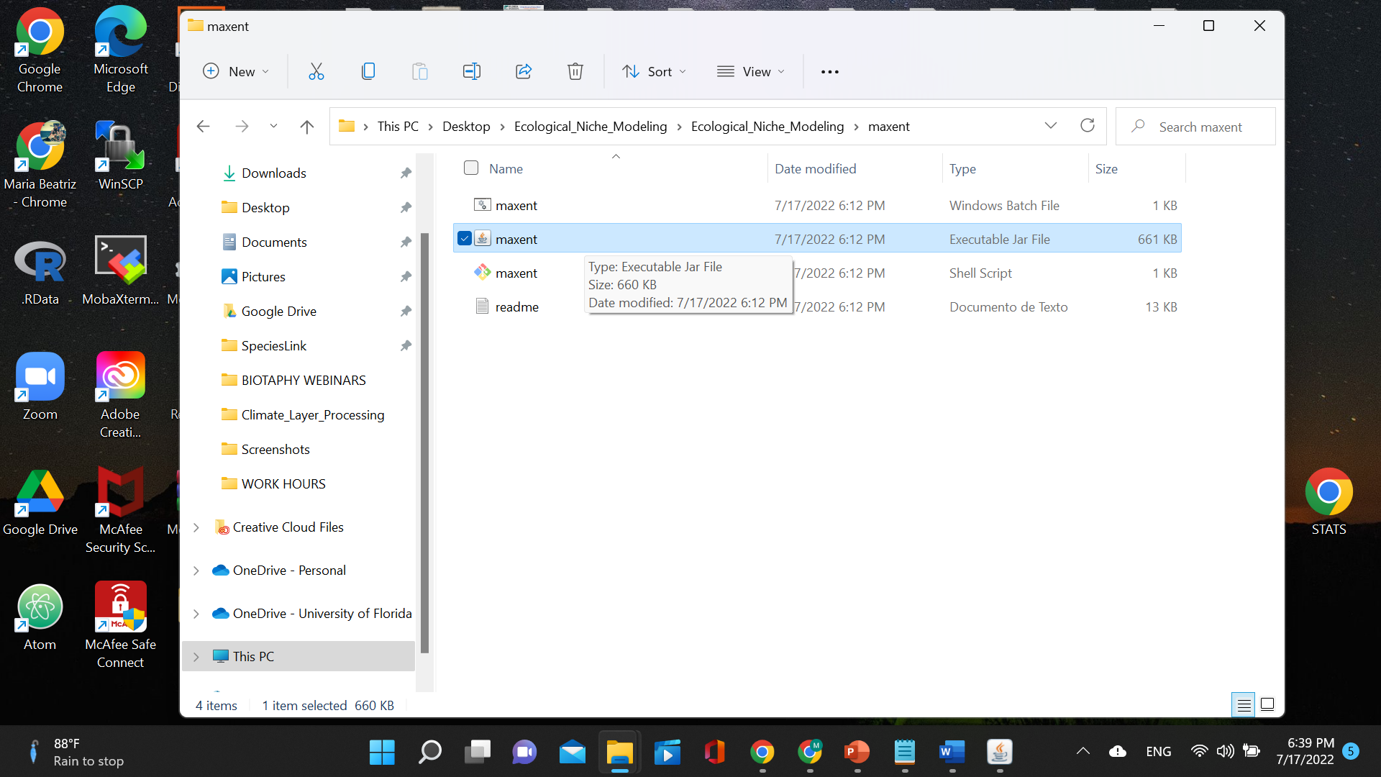
Open Maxent

Slide 21
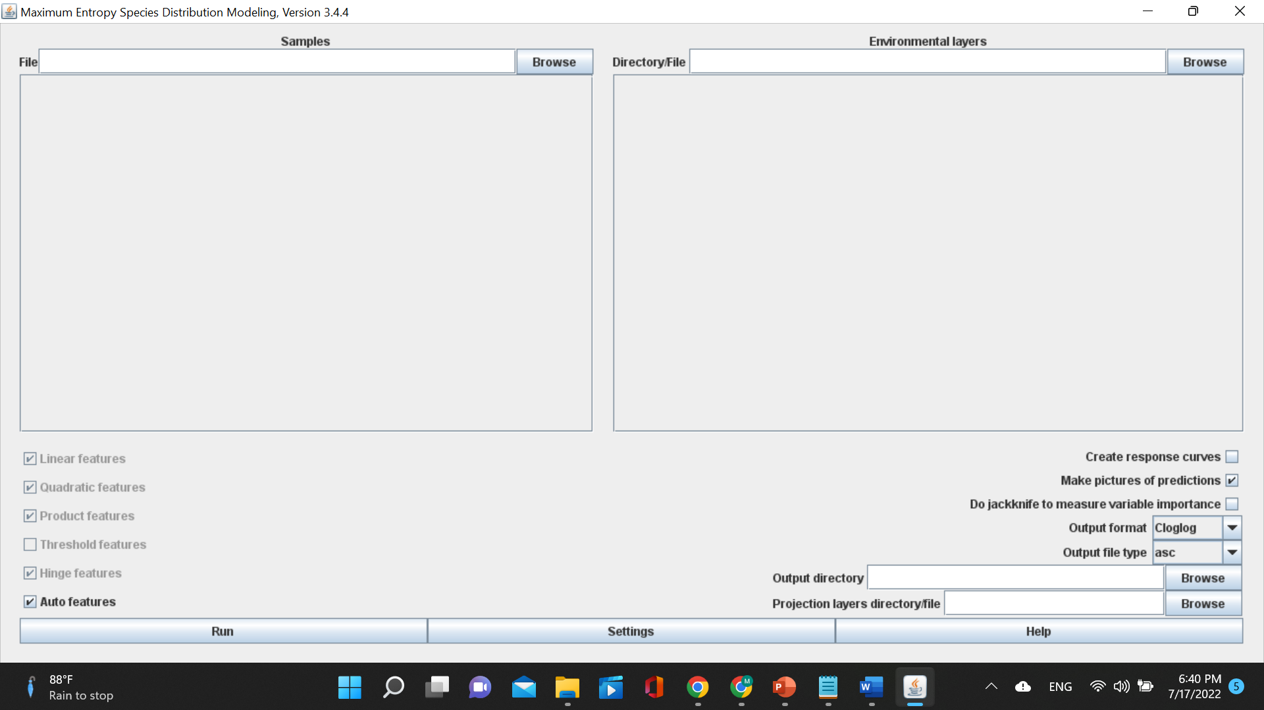
Open Maxent

Slide 22
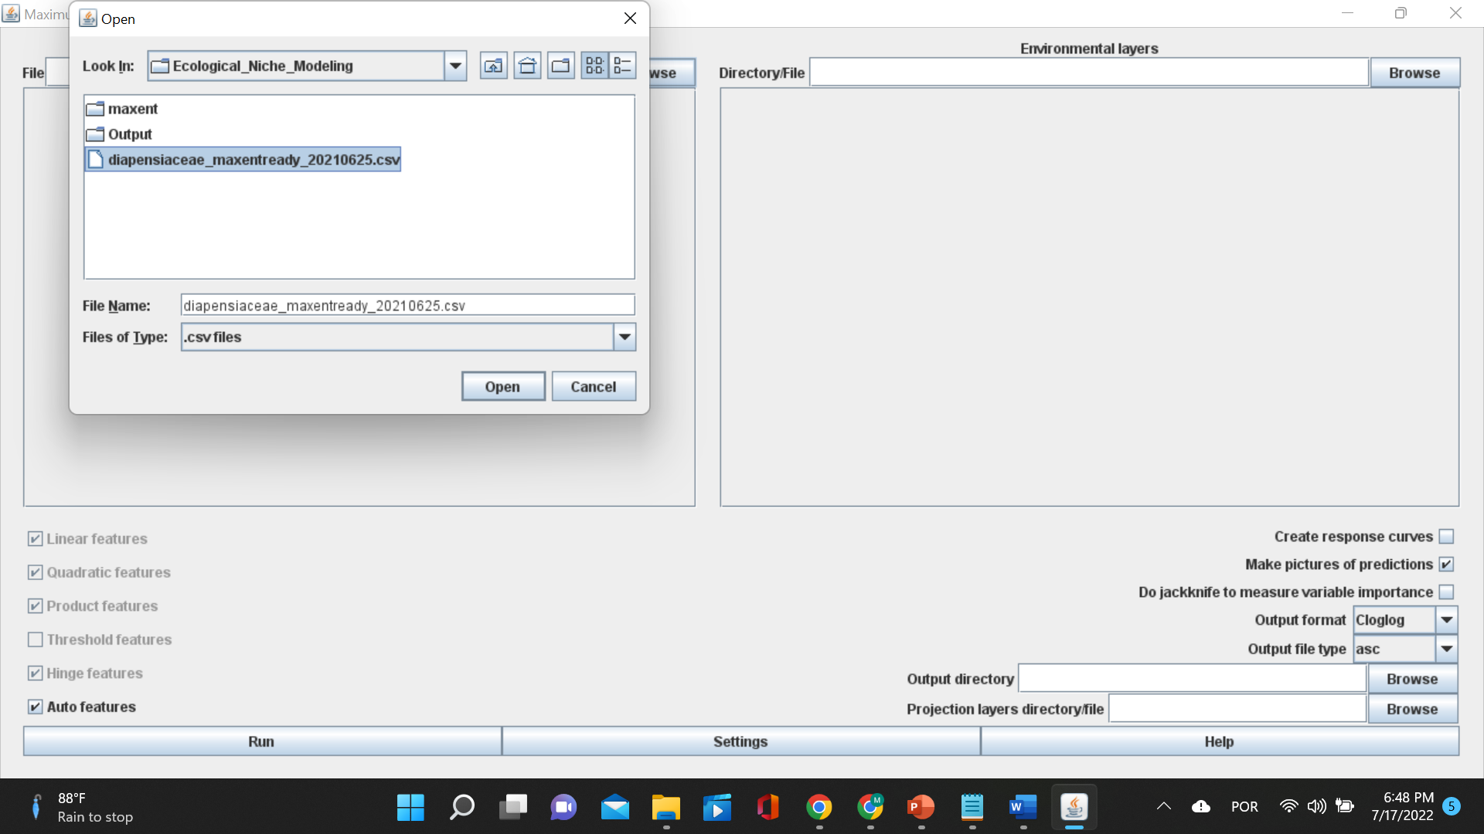
Load occurrence data
Only one species at a time

Slide 23
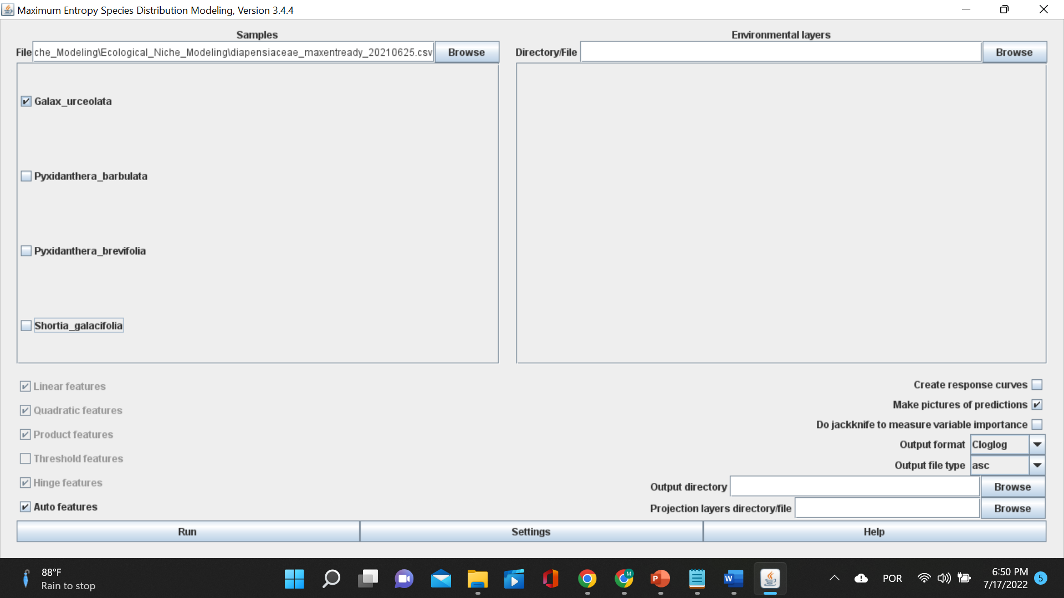
Load occurrence data

Slide 24
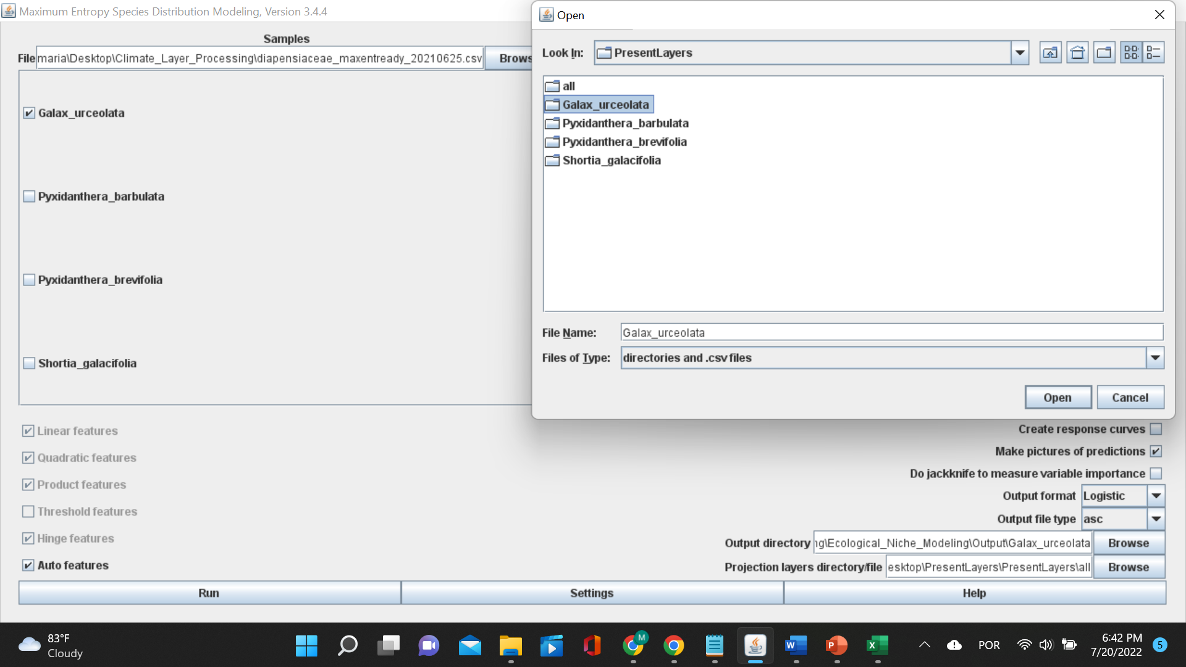
Load species-specific training layers
Select species-specific training layers

Slide 25
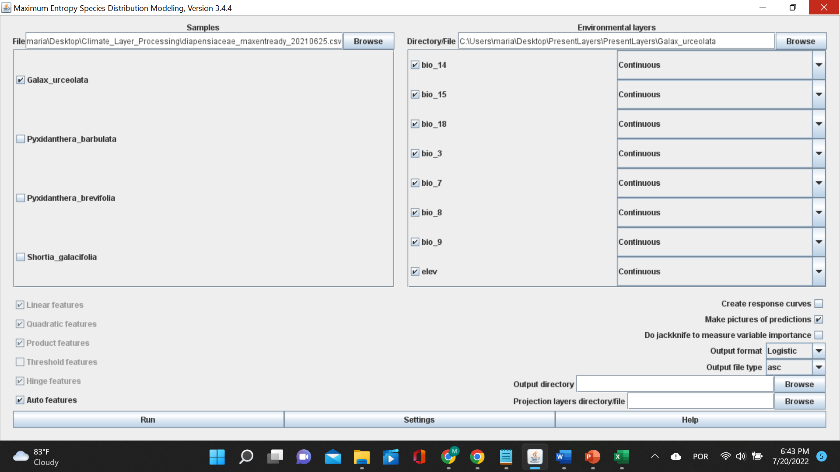
Load species-specific training layers

Slide 26
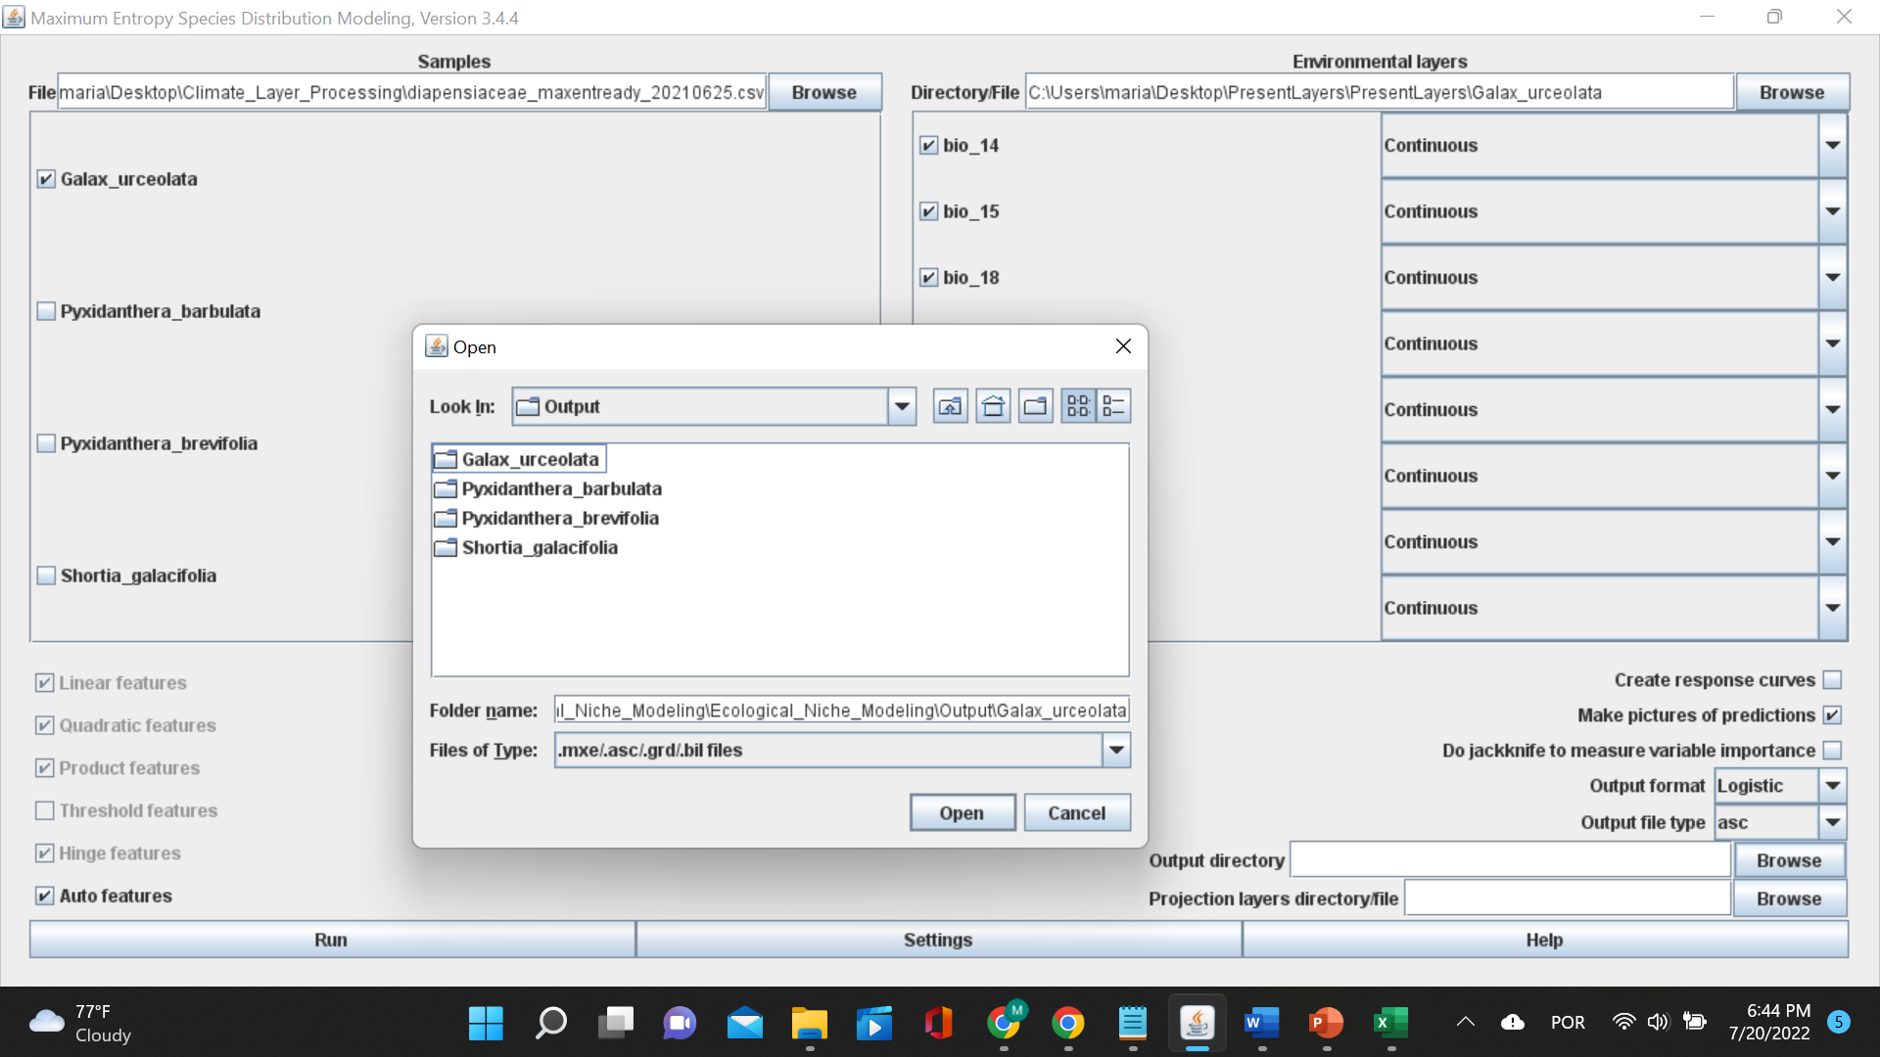
Select output directory
Select output directory

Slide 27
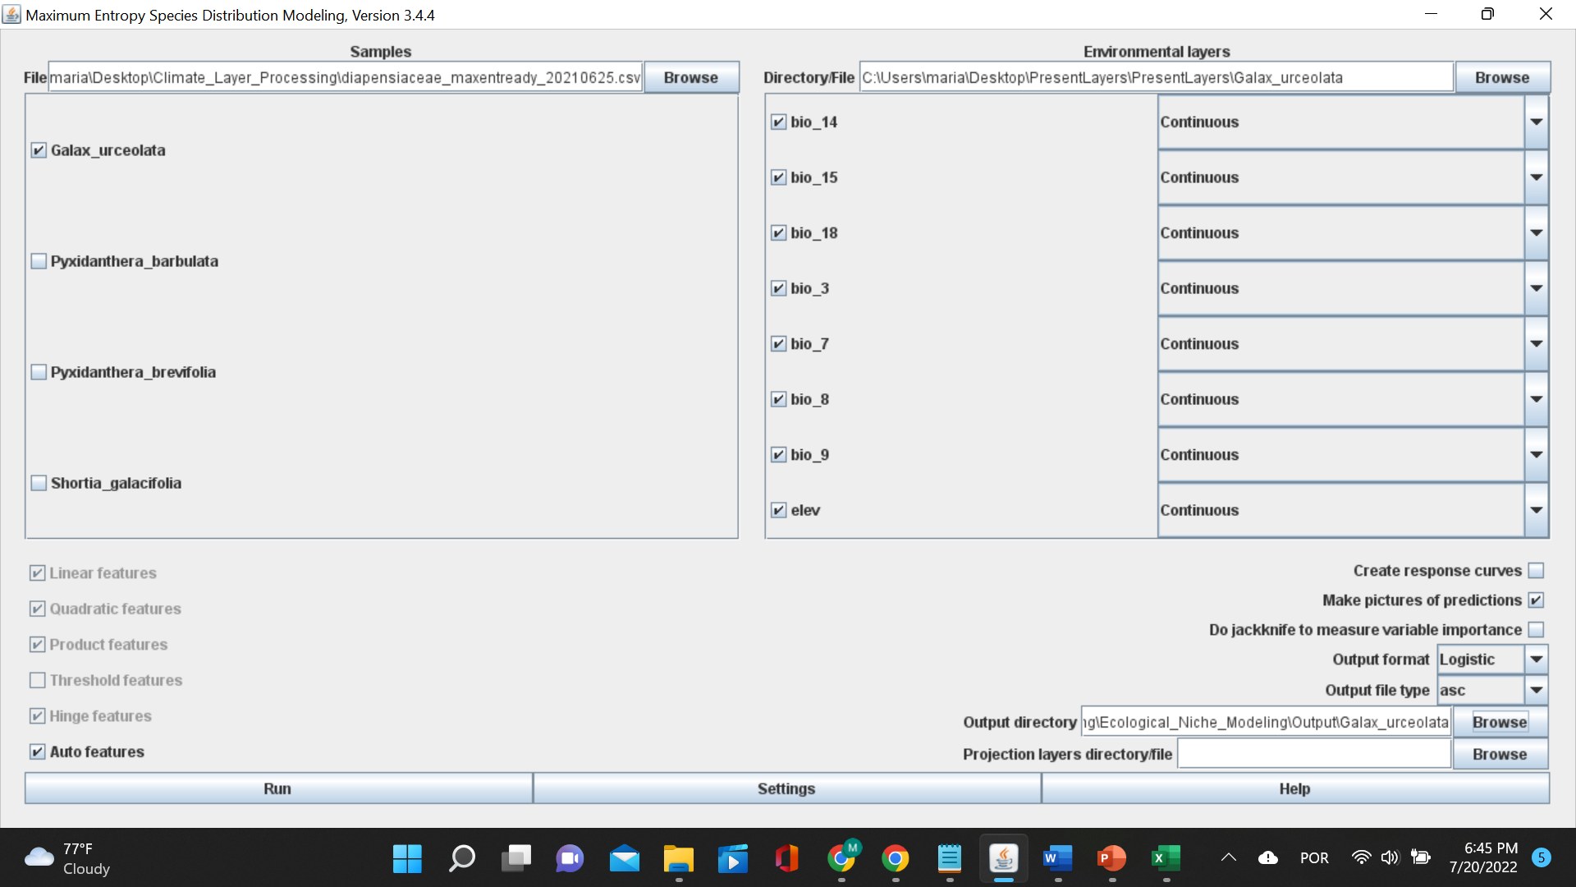
Select output directory

Slide 28
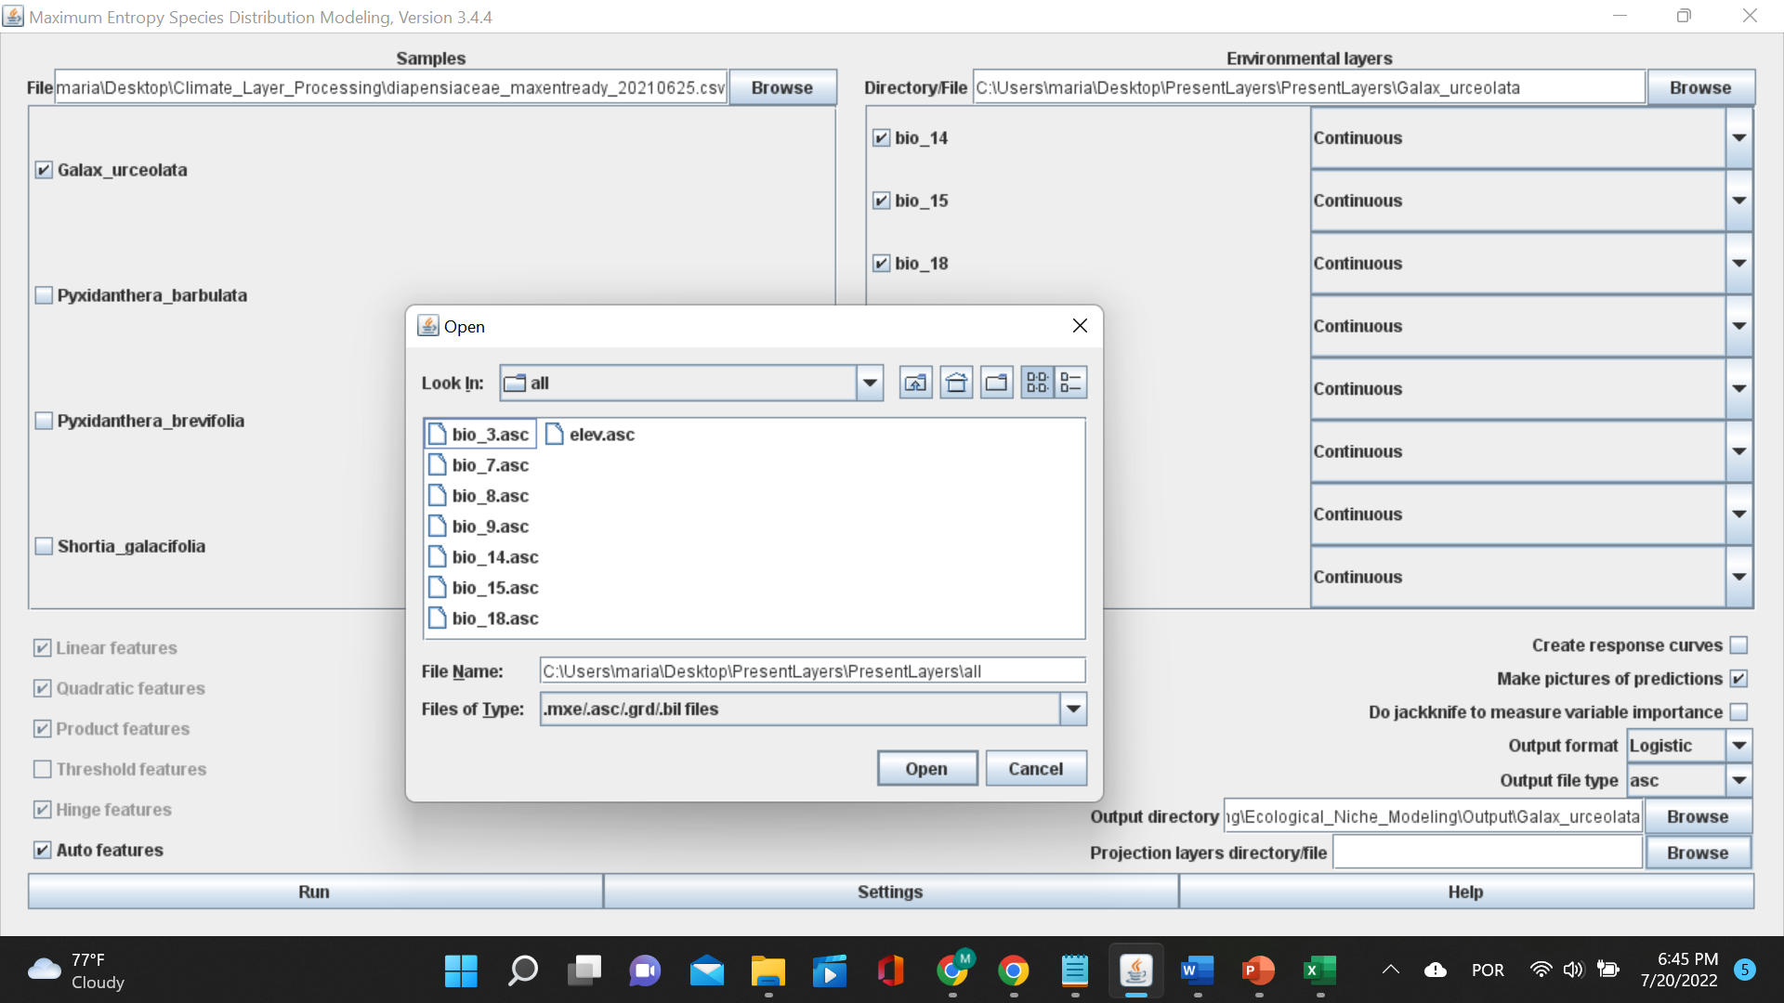
Select projection layers
Select projection layers

Slide 29
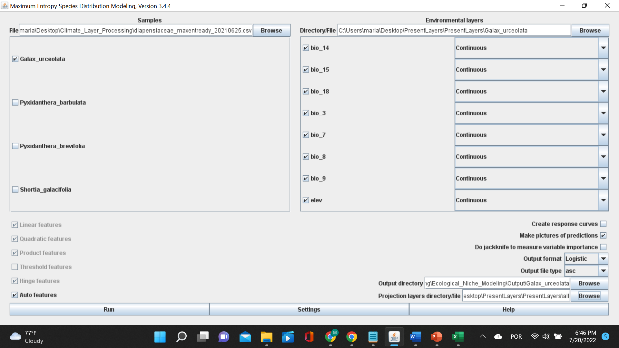
Verify output formats
Logistic calculates the conditional probability of occurrence. The probability will be between 0 - 1.
Select logistic

Slide 30
Verify settings

Slide 31
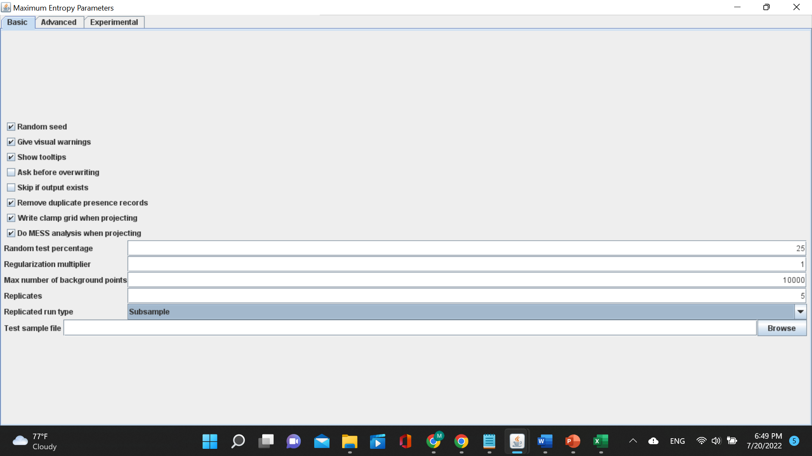
Verify settings – Basic
Subsample: in which the presence points are repeatedly split into random training and testing subsets
Bootstrapping: where the training data are selected by sampling with replacement from the presence points

Slide 32
Verify settings – Basic

Slide 33
Verify settings – Basic
MESS = Multivariate Environmental Surface Similarity (MESS)

Slide 34
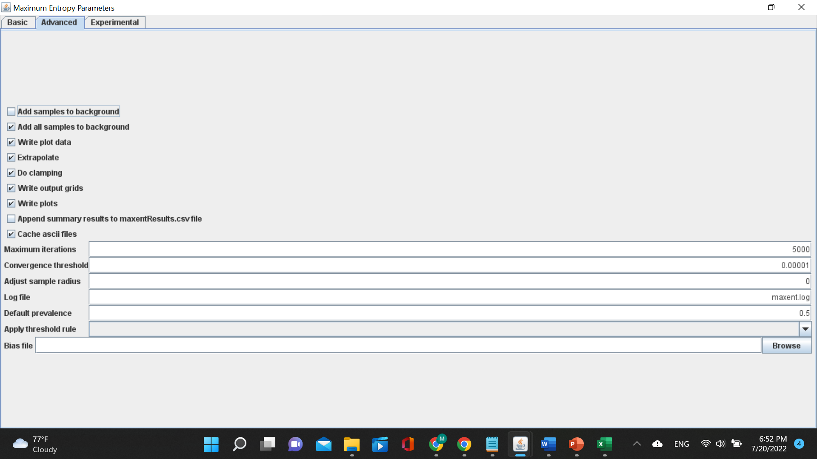
Verify settings – Advanced
Clamping treats variables outside the training range as if they were at the limit of the training range.
Clamp grid depicted is the absolute difference between predictions with and without clamping.

Slide 35
Verify settings – Advanced
Extrapolate = extent to estimate

Slide 36
Verify settings – Advanced
Iterations = allows the model to have adequate time for convergence (coming together)

Slide 37
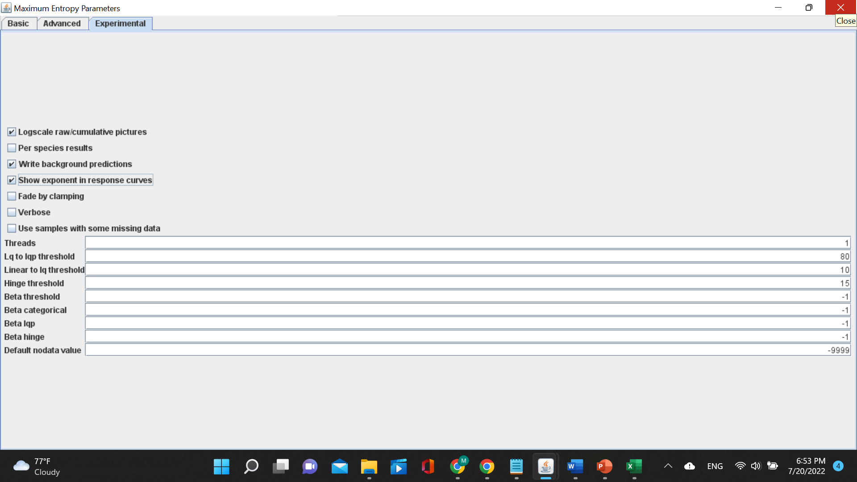
Verify settings – Experimental

Slide 38
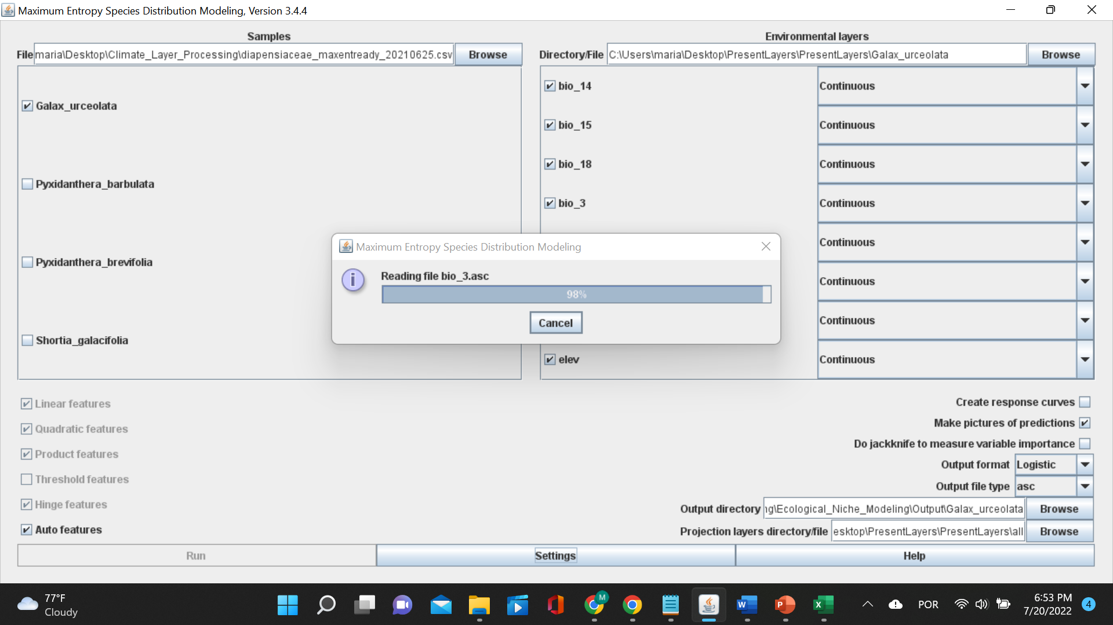
Run Maxent!

